Slide 1
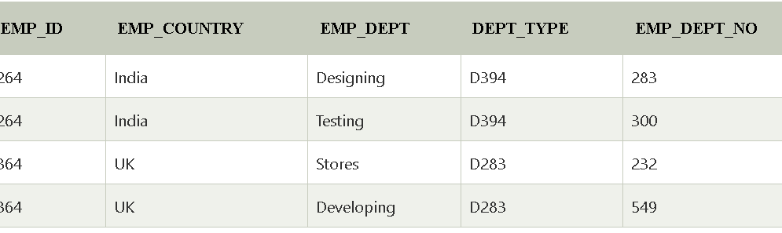
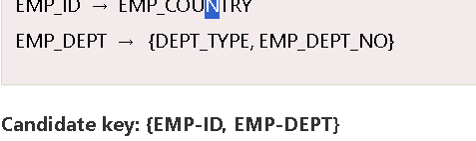
BCNF
BCNF is the advance version of 3NF.
It is stricter than 3NF.
A table is in BCNF if every functional dependency X → Y, X is the super key of the table.
For BCNF, the table should be in 3NF, and for every FD, LHS is super key.
Example: Let's assume there is a company where employees work in more than one department.

Slide 2
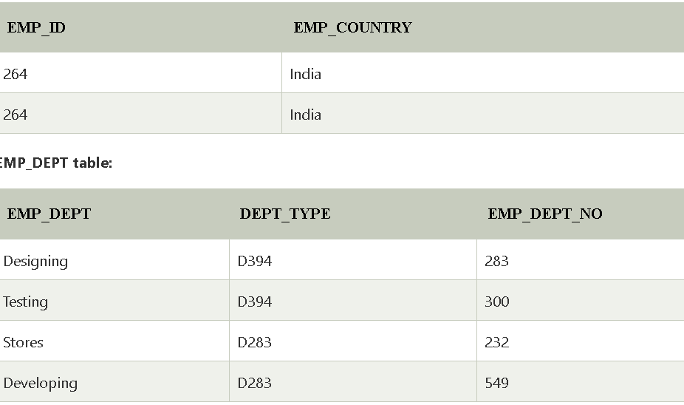
The table is not in BCNF because neither EMP_DEPT nor EMP_ID alone are keys.
To convert the given table into BCNF, we decompose it into three tables:
EMP_COUNTRY table:

Slide 3
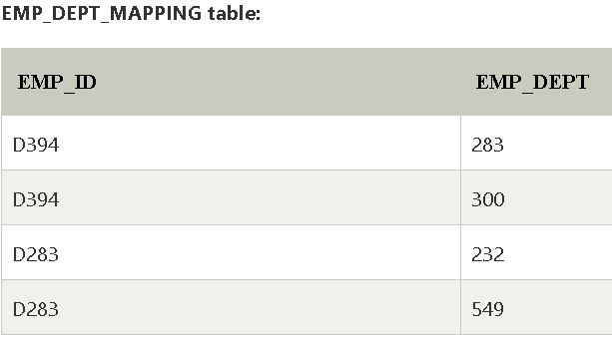

Candidate keys:
For the first table: EMP_ID For the second table: EMP_DEPT For the third table: {EMP_ID, EMP_DEPT}
Now, this is in BCNF because left side part of both the functional dependencies is a key.

Slide 4

.
Fourth normal form
A relation will be in 4NF if it is in Boyce Codd normal form and has no multi-valued dependency.
For a dependency A → B, if for a single value of A, multiple values of B exists, then the relation will be a multi-valued dependency.
Scenario:
Consider a table that stores information about courses, instructors, and the textbooks they use. The table might look like this:

Slide 5
Candidate Keys: (CourseID, Instructor) and (CourseID, Textbook).
Multivalued Dependencies:
CourseID →→ Instructor
CourseID →→ Textbook
In this table:
Each course can have multiple instructors.
Each course can use multiple textbooks.
There is no direct relationship between instructors and textbooks.
The table has redundant data due to the fact that one course can have multiple instructors and multiple textbooks independently.
This violates the Fourth Normal Form (4NF), which states that a table should not have more than one multivalued dependency that is independent of a candidate key.

Slide 6


Slide 7
Each table is in 4NF because there is only one multivalued dependency in each table, and no more redundancies exist.

